Slide 1
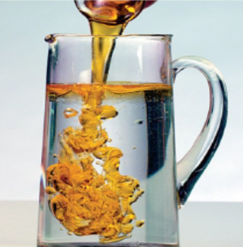
Organic Chemistry
1st stage students
2nd Course
dr.Huda S.Abood

Slide 2
Hydrocarbons
On the basis of structure, hydrocarbons are divided into two main classes, aliphatic and aromatic.
Certain organic compounds contain only two elements, hydrogen and carbon, and hence are known as hydrocarbons.
Aliphatic hydrocarbons are further divided into families: alkanes, alkenes, alkynes, and their cyclic analogs (cycloalkanes, etc.).

Slide 3
Aliphatic and aromatic compounds

Slide 4
Alkanes
Aliphatic and aromatic compound (contain other elements in addition to C, H like O, N) this compounds called hydrocarbon derivatives such as alcohol, ether, amines, ….).

Slide 7
Structure of alkane
The simplest member of the alkane family and, indeed, one of the simplest of all organic compounds is methane, CH₄, n=1. When n=2, C₂H₆ is ethane.
CnH2n +2
n= number of Carbon atom, n=1,2,3
1-Molcular formula (MF) CH_{4,} C₂H₆, C₃H₈, …

Slide 8



2-Structure formula
propane
3-Bond-line formula
3-methyl pentane

Slide 9
Alkanes
Alkanes are organic compound with only C-C and C-H single (σ) bonds.
General formula for alkanes C_{n}H_{2n}+2, saturated hydrocarbons.
Isomer: compounds with the same chemical formula but different arrangement of atoms.

Slide 11
Physical properties (mp., bp.,solubility)

Slide 12
When M.wt increase melting point (MP.) increase.
Alkanes non polar compounds dissolve in non-polar solvent (liquid).
Branched isomer have a lower mp. than straight isomer.
Ex. n-butane bp. (boiling point) 0ºC.
Isobutene bp. -12ºC .
Alkanes show: regular increase in bp and mp as the molecular
weight increase. Branching lowers the bp or alkanes
n-pentane bp= 36.1 °C
iso-pentane bp= 27.9 °C
neo-pentane bp= 9.5°C

Slide 13
That branching should lower the boiling point is reasonable: with branching the shape of the molecule tends to approach that of a sphere; and as this happens the surface area decreases, with the result that the intermolecular forces become weaker and are overcome at a lower temperature.

Slide 15
Systematic Nomenclature (IUPAC system)
IUPAC International union of pure and applied chemistry

Slide 16
Common Name
Prefix –substitution
Parent-number of carbons
Suffix-functional groups
Prefix n (normal) straight alkane
Iso (one branched on the alkane)
Neo (two branched on the alkane)

Slide 17

Alkyl substituents (group):
carbon chains which are a substructure of a molecule One carbon group
of a main chain

Slide 18


Isomer of alkane
CH₃CH₂CH₂CH₂CH₃ n-pentane
Isopentane neopentane

Slide 19
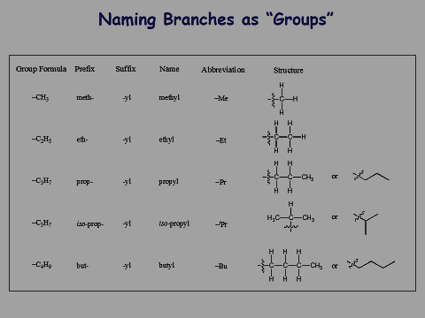
Naming Branches as Groups

Slide 20
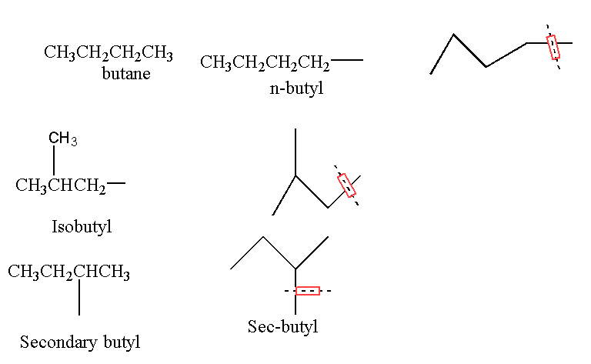

Slide 21
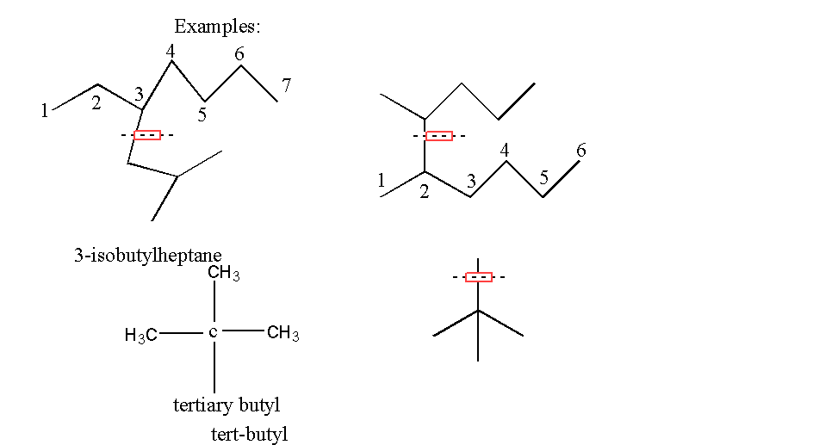
2-Sec-pentyl hexane

Slide 22
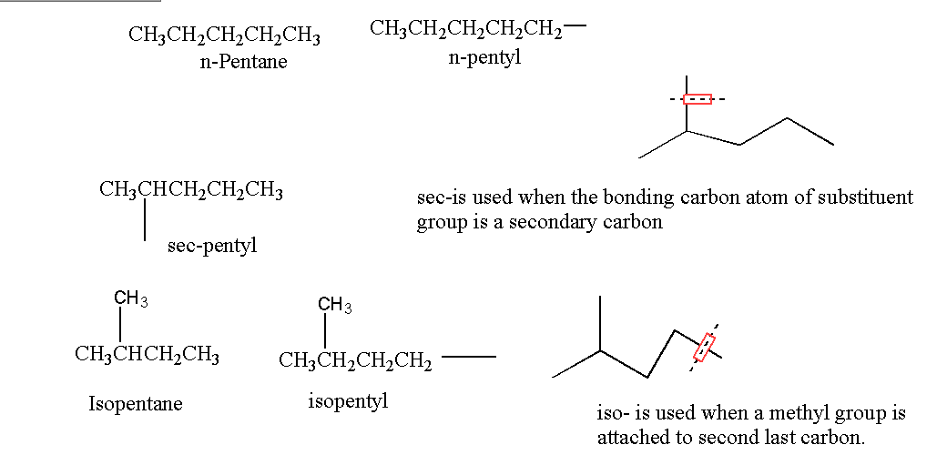

Slide 23
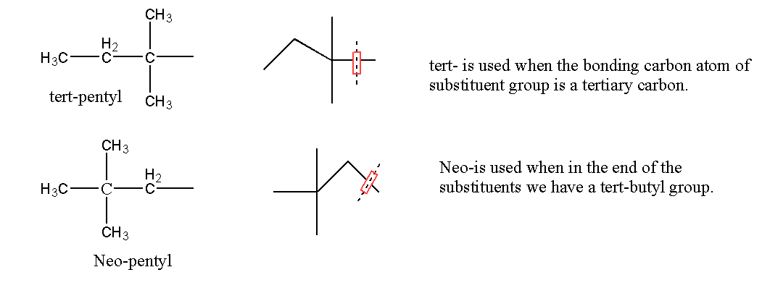

Slide 24


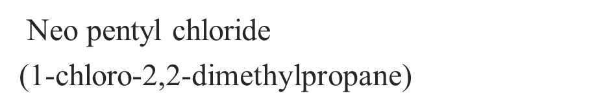
Alkyl halide
iso propyl bromide
(2-bromo propane)
CH3 (CH₂)₅I
n-hexyl Iodide
(1-iodo hexane)

Slide 25
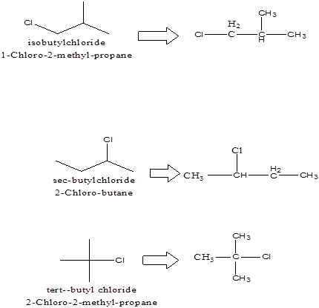

Slide 26
Rule for systematic Nomenclature of Alkanes

Slide 27
Rule for systematic Nomenclature of Alkanes
b-If more than one different chains are of equal length (number of carbons).choose the one with the greater number of branch points (substituents) as the parent.

Slide 28
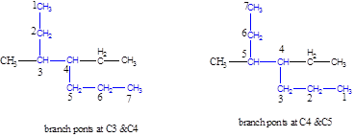

Slide 29
b. If there is branching equidistant from both ends of the parent chain, number so the second branch point has the lowest number. Use commas to separate two numbers (Ex:2,2) and use hyphens to separate numbers from words.(Ex:2-methyl)
3-ethyl-4,7-dimethyl nonane

Slide 30
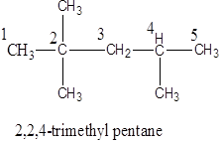
c. If the same alkyl group occurs more than once as side chain indicate this by the prefix (di, tri, tetra, etc….)

Slide 31
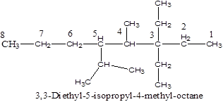
d- If there are several different alkyl group attached to the parent chain. Name them in order of increase size.
4-methyl-3,3-dimethyl-5-isopropyl octane

Slide 32
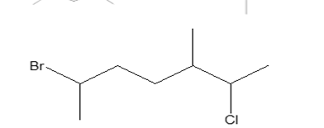
H.W : what is the name of the following alkanes

Slide 33
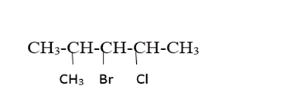
e-If there another group on the parent chain (not alkyl group) it will arranged by alphabetical order.
3-bromo-4-chloro-2-methyl pentane

Slide 34

(CH3) Methyl group: 1° hydrogens primary hydrogens
(CH2) methylene group: 2° hydrogens secondary hydrogens
(CH) methine group: 3° hydrogens tertiary hydrogens
A primary (1°) hydrogen is a hydrogen atom residing on a primary carbon in an organic species.

